Slide 1
Head First
Chapter-8:
Interfaces and Abstract classes
Upcode Software
Engineer Team
-2023-

Slide 2
CONTENT
What’s an abstract class?
What’s an interface?
Why/Where do we need to abstract the class?
Why/Where do we need an interface?
Abstract class vs Interface
Using polymorphic references of type Object
Conclusion
References and used materials;

Slide 3

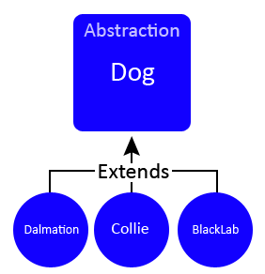
What is an abstract class
It’s a class that can’t be instantiated
The compiler won’t let you instantiate an abstract class
You don’t have to worry about somebody making objects of that type. The compiler guarantees it.
An abstract class has virtually* no use, no value, no purpose in life, unless it is extended.

Slide 4
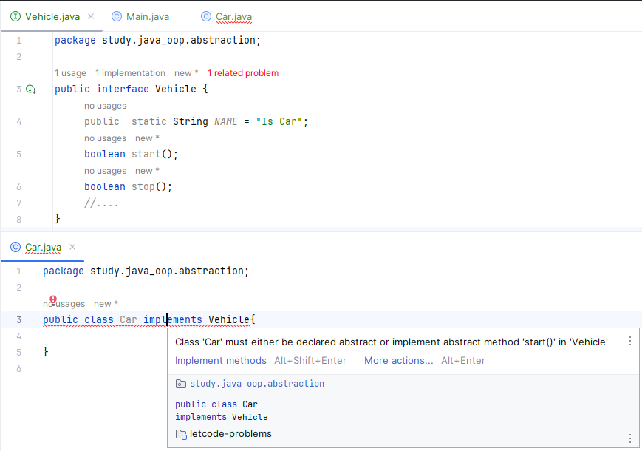
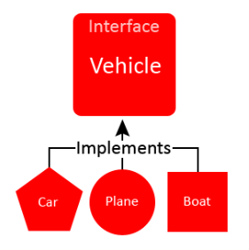
What is an interface
It’s a 100% abstract class
Interfaces are the poly in polymorphism. (poly = many morphism = behavior or form)

Slide 5
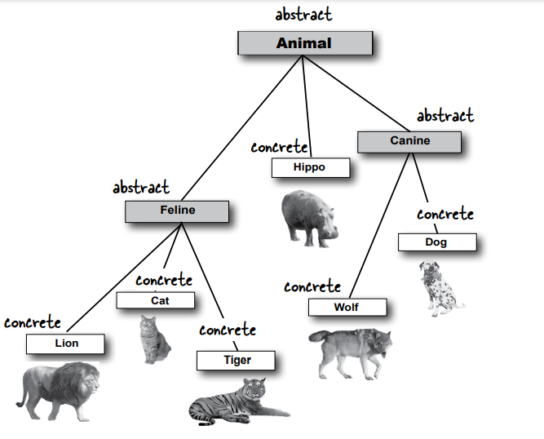
Why/Where do we need to abstract class?
We need to go beyond simple inheritance to a level
Flexibility and extensibility you can get only by designing and coding to interface specifications

Slide 6
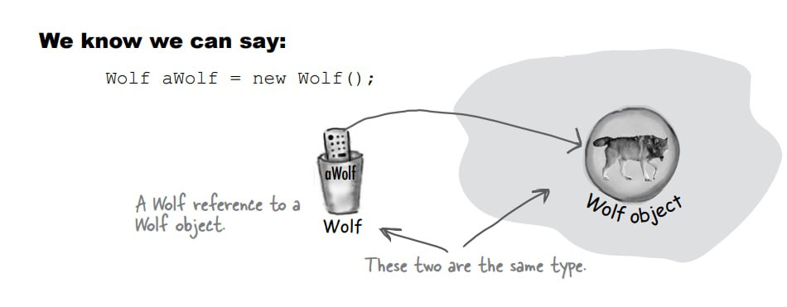
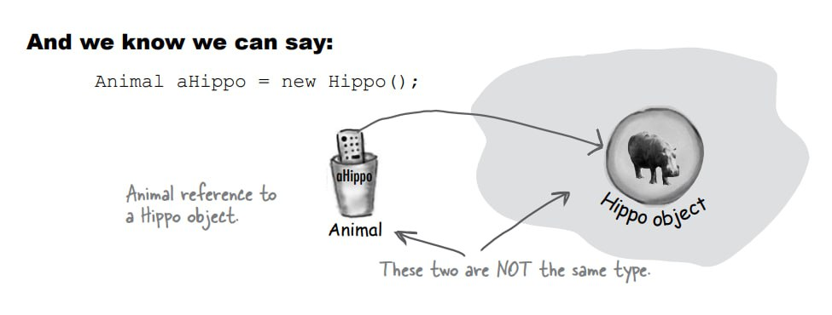
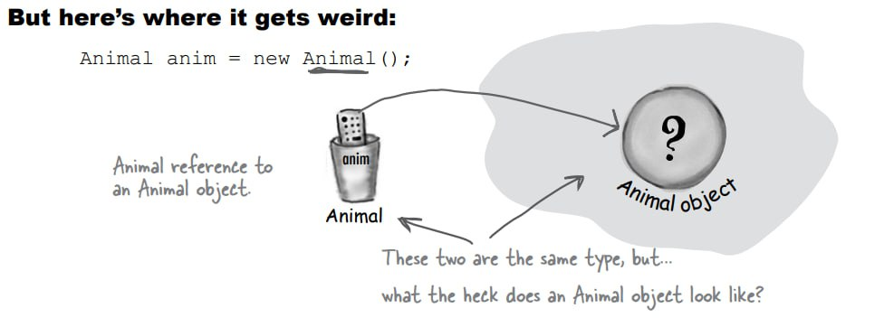
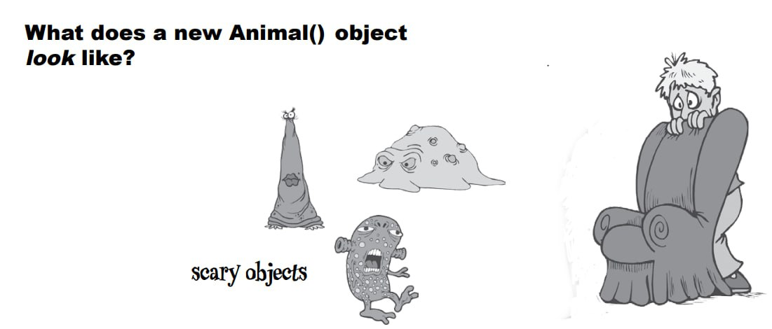
Where do we use it?

Slide 7
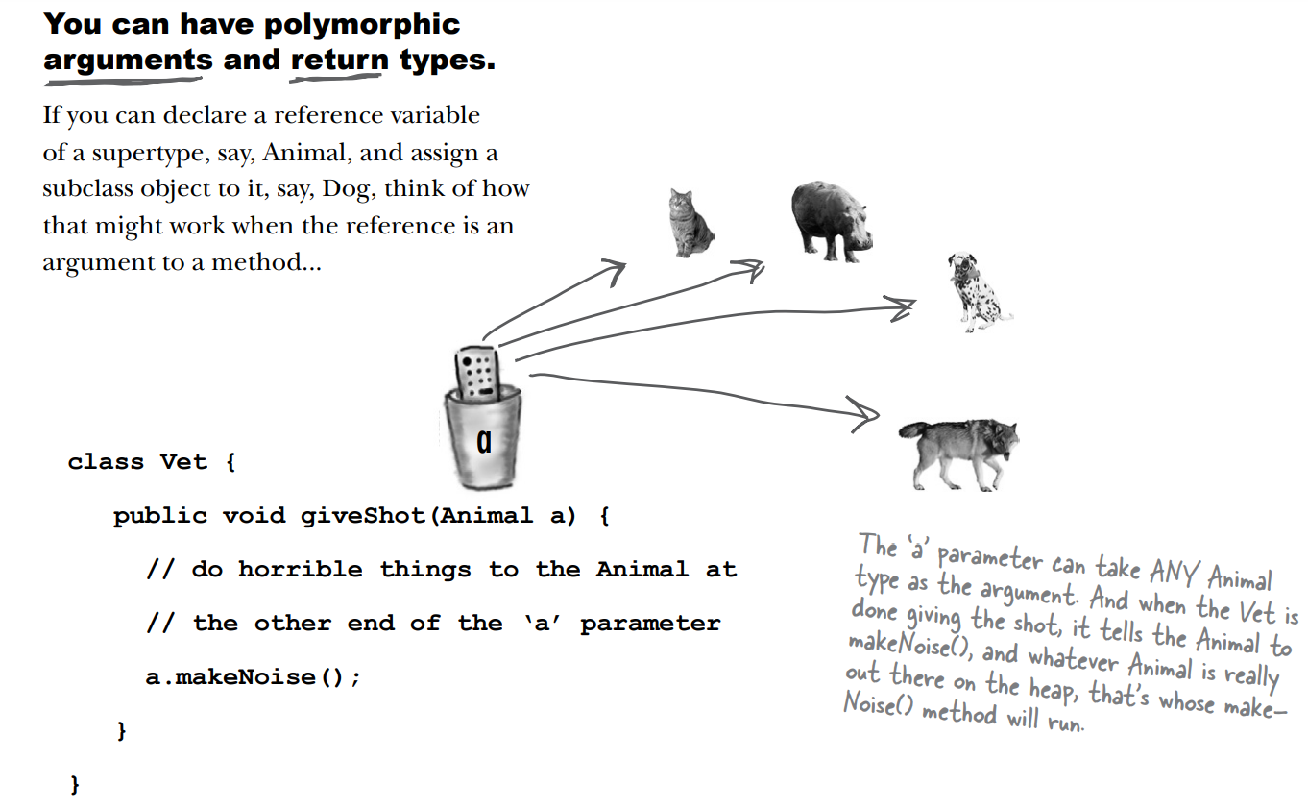
Where do we use it?
Polymorphism! Remember, what you want is the ability to use a superclass type (often abstract) as a method argument, return type, or array type.

Slide 8
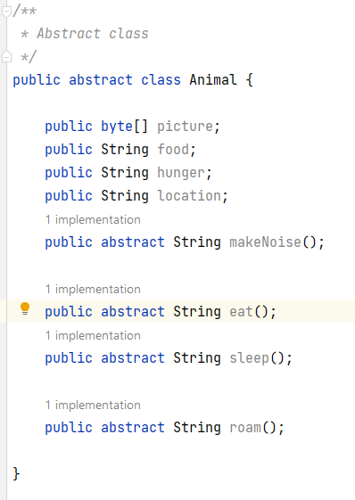
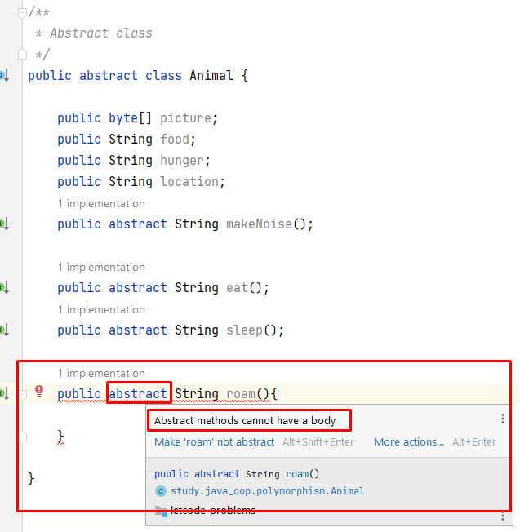
Abstract method.
Abstract methods don’t have a body; they exist solely for polymorphism
An abstract class means the class must be extended; an abstract method means the method must be overridden.

Slide 9
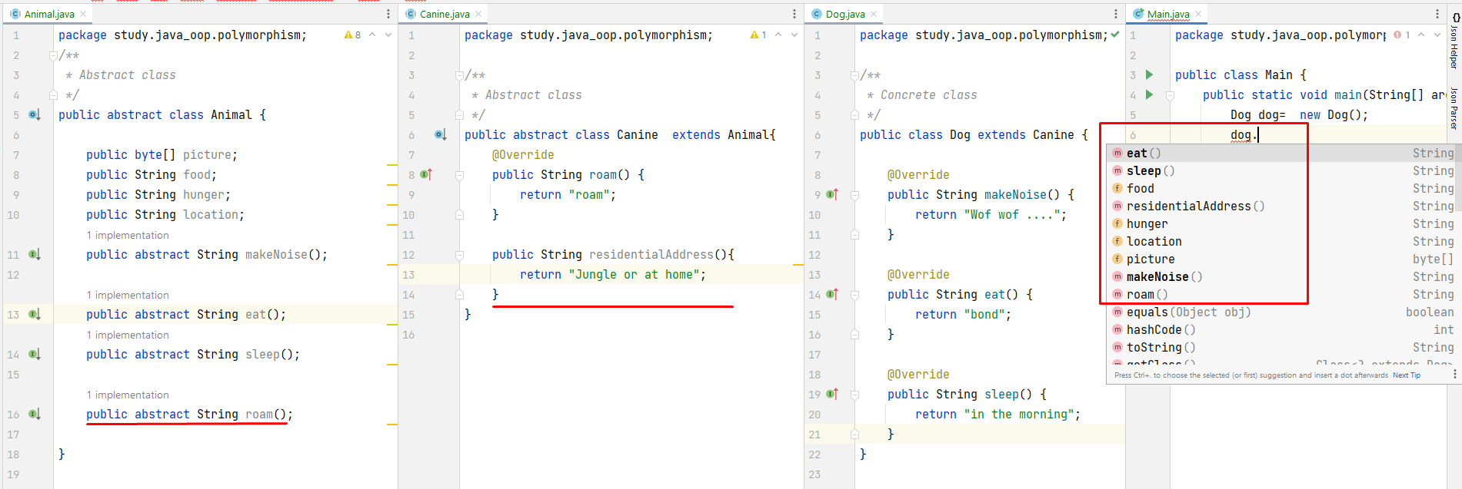
Why/Where do we need to abstract class?
You can’t think of any generic method implementation that could possibly be useful for subclasses.

Slide 10
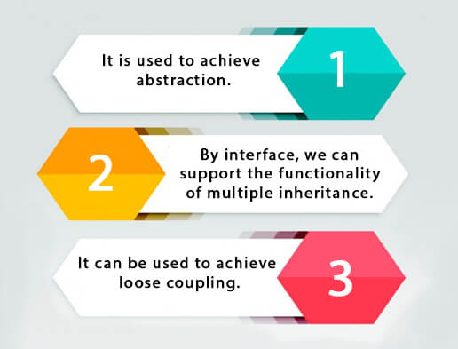
Why/where do we need an interface?
Why do we need an interface
In Java, an interface specifies the behavior of a class by providing an abstract type.
As one of Java's core concepts, abstraction, polymorphism, and multiple inheritance are supported through this technology.
Interfaces are used in Java to achieve abstraction.
Need for Interface in Java

Slide 11
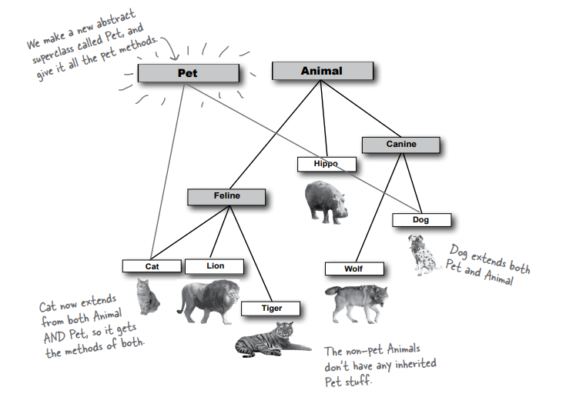
Why/where do we need an interface?

Slide 12
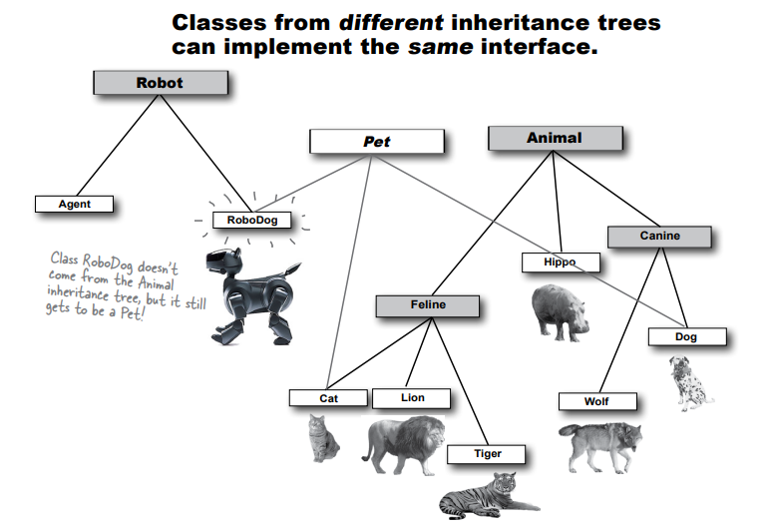
Why do we need an interface?

Slide 13
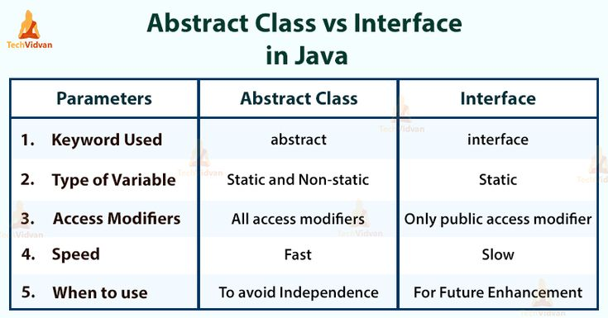
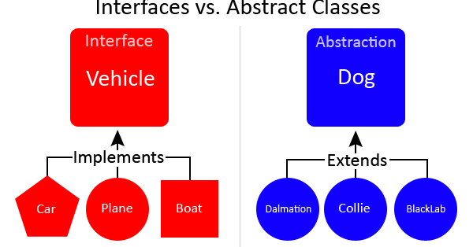
Abstract class and Interface
clean install -U -X

Slide 14
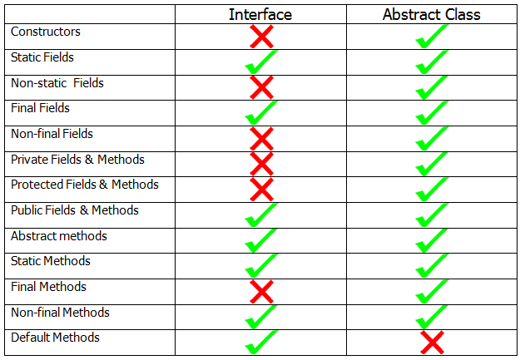
Abstract class and Interface

Slide 15
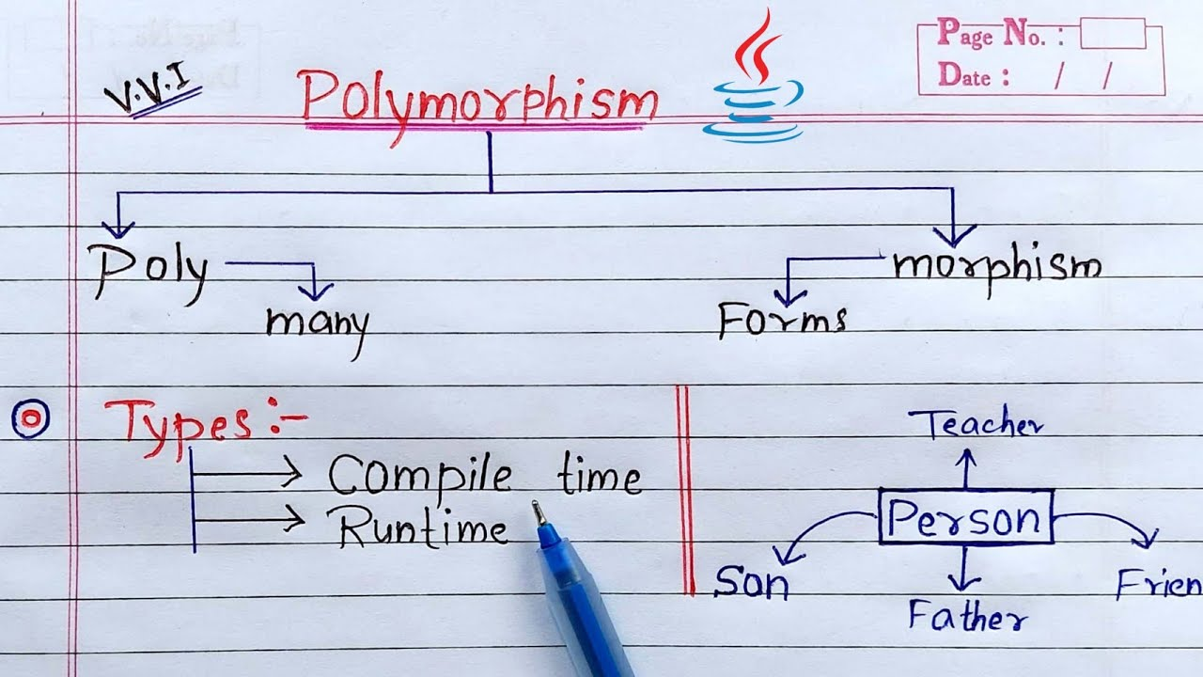
Polymorphism

Slide 16
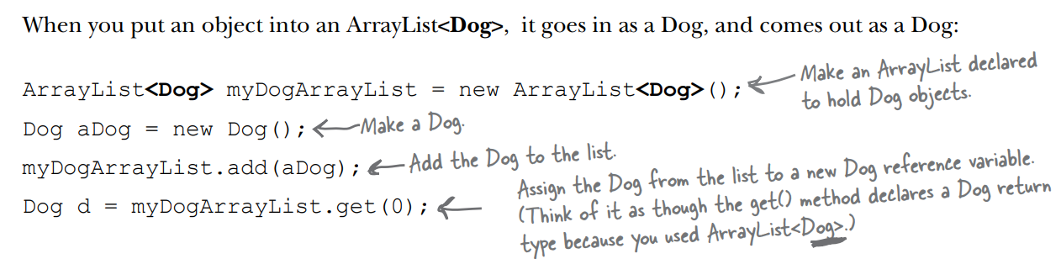
Using polymorphic references of type Object

Slide 17
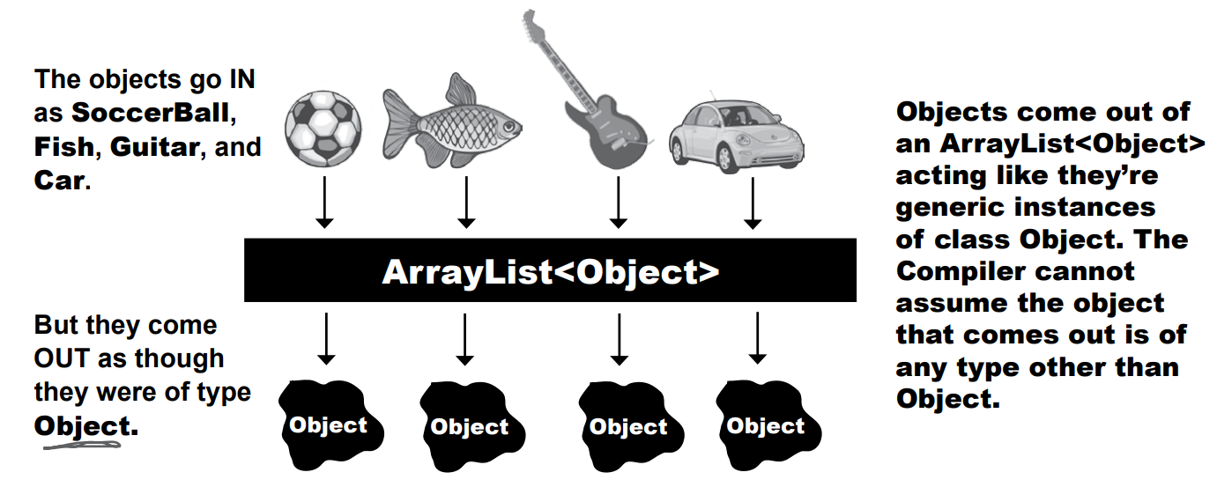
Using polymorphic references of type Object

Slide 18
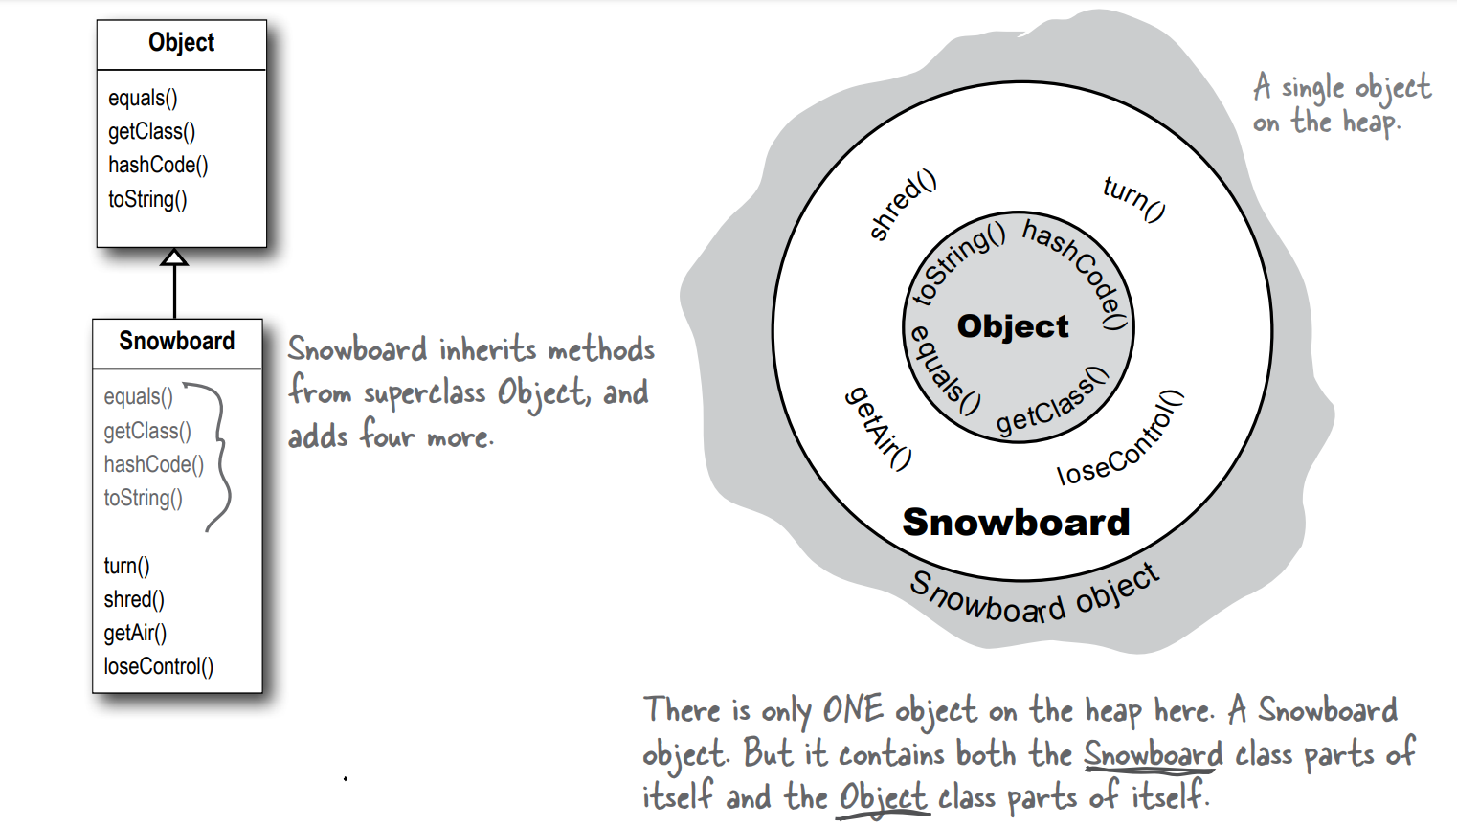
Using polymorphic references of type Object

Slide 19
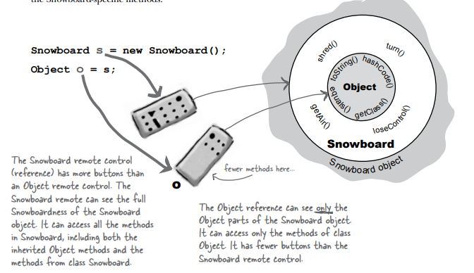
Using polymorphic references of type Object
‘Polymorphism’ means ‘many forms’.
When you put an object in an ArrayList<Object>, you can treat it only as an Object, regardless of the type it was when you put it in.
When you get a reference from an ArrayList<Object>, the reference is always of type Object

Slide 20
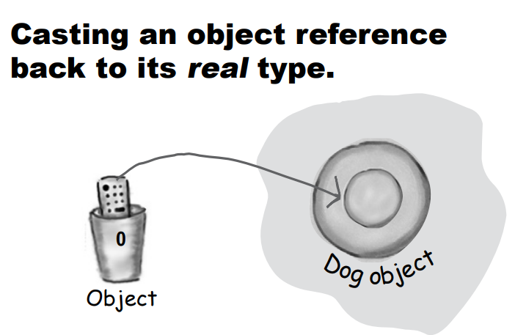
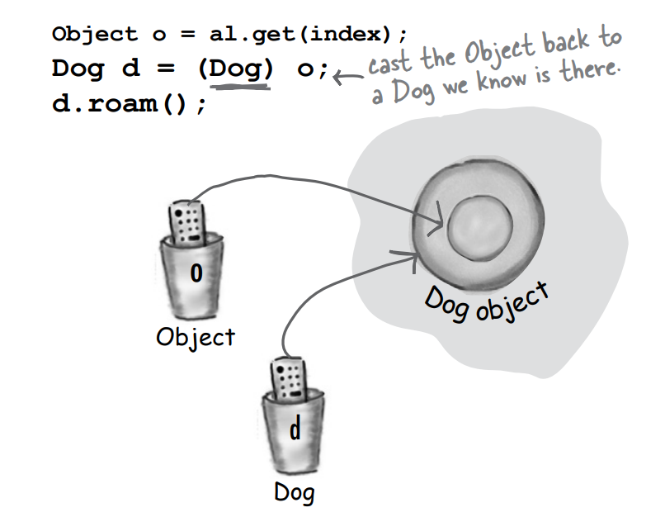
Casting Object

Slide 21
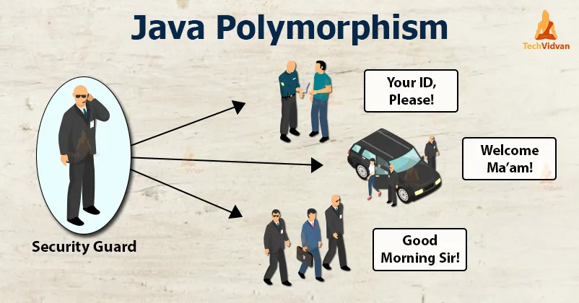
‘Polymorphism’ means ‘many forms’.

Slide 22
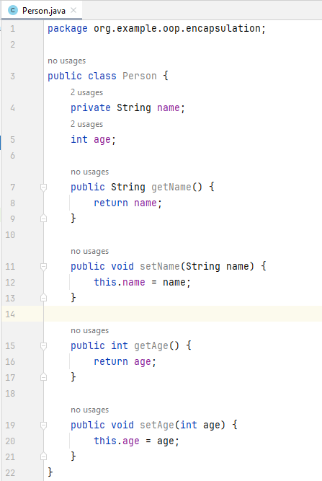
Encapsulation

Slide 23
Thank you!
Presented by
Temurmalik Nomozov
(temirmaliknomozov@gmail.com)

